Slide 1
Kuehne + Nagel
Internships

Slide 2
About Kuehne+Nagel
> 78,000
Professionals delivering excellence to customers every day
400,000
customers trust us to manage their logistics
1,395
offices worldwide, so that we are close to our customers
109
countries, connected by our network
No.1
sea freight worldwide
No.2
air freight worldwide
No.4
Road logistics in
Europe
No.2
contract logistics
All figures relate to 2021
Notes:
Professional sitting on the shoulder of a big giant
Contribute to something what has big impact world wide

Slide 3

Tallinn IT Centre 550+ specialists
Notes:
KN IT School

Slide 4



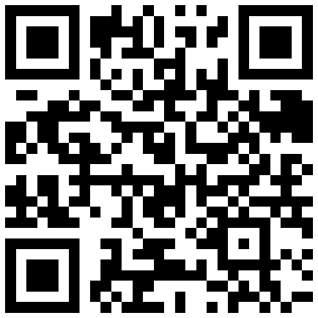
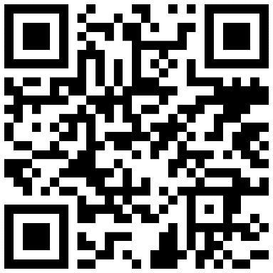
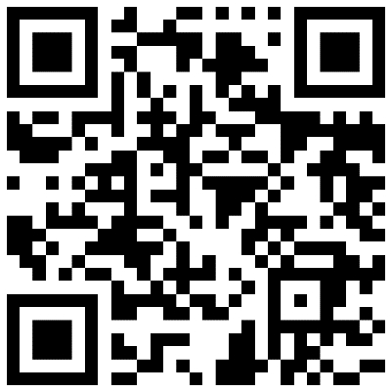
Internships offered in Tallinn
Full stack Developer
Devops Engineer
IT Support Engineer
Notes:
KN IT school project
- Design and deliver internship program
- Trainee is unique
GOAL
- Deliver to each trainee BEST Internship Experience
- Right challenge, right amount of time, right mentorship

Slide 5

Your Journey into Professional IT

Slide 6
Time availability
Students
Workers
Ready to work

Slide 7

Inspire
Notes:
Mentorship will look like a tour guide in technology. To make sure that you

Slide 8

Empower

Slide 9

Deliver

Slide 10










Internship Programs 2022
Empower
Deliver
Inspire
Basic
Frameworks
Team Stack
Variable
10+ hours
Full time
Not compensated
Not compensated
Compensated

Slide 11






Internship Programs 2022
Empower
Deliver
Inspire
Trainings
Younicorn
Elite
Live remote learning sessions. Catalog of learning resources
One trainee One research project
Team of trainees. Work on KN product prototype.
Open source
Guild
Workforce
Hybrid team employees/trainees Supply chain product prototype
Team of trainees Product prototype
Join KN team in their working routines on production project.

Slide 12

When to apply?
March Spring Internships
October Winter Internships
Deadline 15th March
Java React Fullstack DevOps engineer
It Support
June Summer Internships

Slide 13
How to apply?
https://jobs.kuehne-nagel.com/global/en
Want to know more?
kn.it.school@kuehne-nagel.com

